Slide 1
Google My Business
Beginner
LAST UPDATED | JULY 16, 2021
DISOVER THE MOST POWERFUL FREE ONLINE TOOL FOR SMALL BUSINESSES.

Slide 2
Ecommerce
Web Development
Branding
People First Marketing
Email Marketing
Film & Photography
Education
Using transparency and communication to build business relationships.
Crowdfunding
Digital Marketing
P: 519-835-3009
E: hello@2h.media

Slide 3
What You’ll Learn
What is a GMB
Why it’s important
Account setup
Managing the basics
Adding company branding
Starting verification
Q & A

Slide 4
Where can I see a GMB listing
Go to www.google.com
In the search field type the name of any small or medium sized business.
Hauser Company
Arabella Park Beer Bar
2H Media

Slide 5
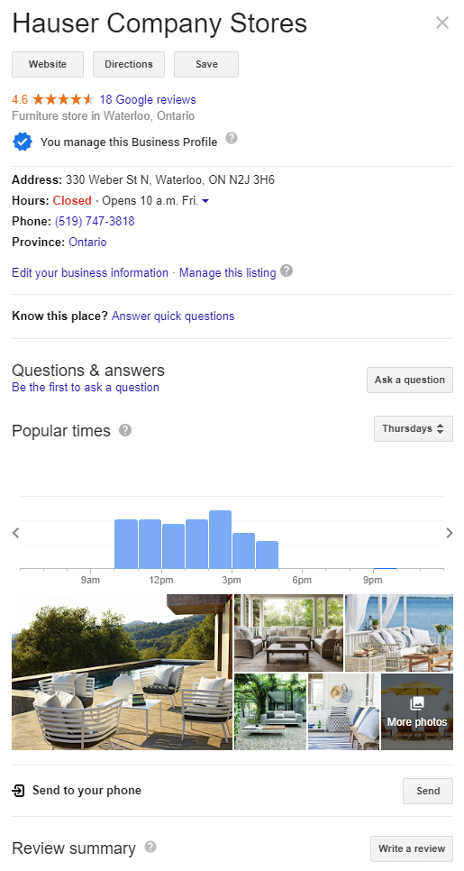

Slide 6
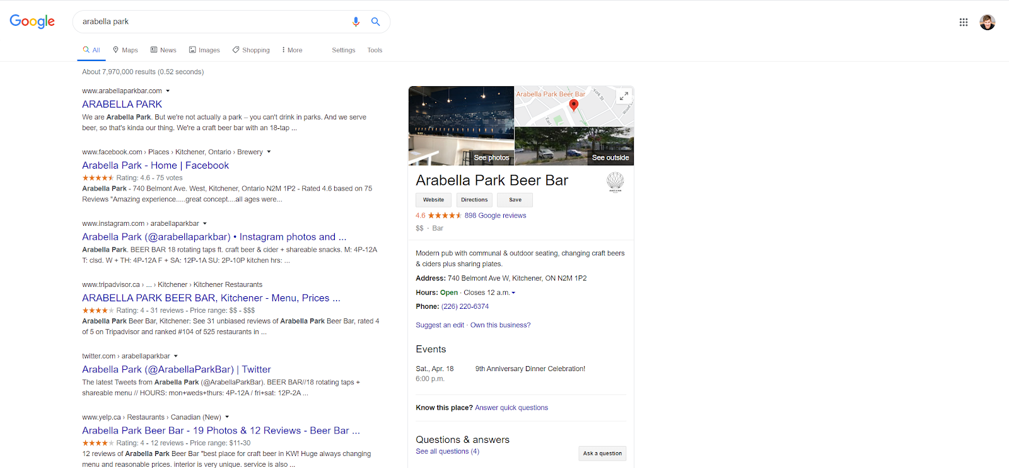

Slide 7
01
Creating Your GMB

Slide 8
Starting From Scratch
STEP BY STEP
Open a web browser
In the search bar enter www.google.com/business
Sign in with your Gmail account*
*If you don’t have a Gmail account raise your hand.

Slide 9
Adding A New Location

Slide 10
Find Your Location

Slide 11
Finding The Right Category
DETAILS
There are over 3000 Google My Business categories
You can have only 1 Primary Category
Can have up to 10 subcategories, but fewer is recommended

Slide 12
Add Your Business To Google

Slide 13
Optimizing Your Business Category
For best results:
Be as specific as possible
Add the least number of categories as possible
Describe your business, not your amenities
If you are adding a new restaurant to Google My Business and that restaurant has a bar, you should not add “Bar” as a category because that does not describe your business, it describes your amenities.

Slide 14
Bricks & Mortar vs Online
WE HAVE 2 SEPARATE OPTIONS
Having a service area without a location
Displaying your physical store address
We will start with the service area. If you have a physical store please find 3 photos of your physical location.

Slide 15
Do You Have A Physical Location - NO

Slide 16
What Are Your Service Locations?

Slide 17
Do You Have A Physical Location - YES

Slide 18
Adding Your Basic Information

Slide 19
Opt Out Of Email Updates

Slide 20
Verify Later

Slide 21
What Are Your Operating Hours?

Slide 22
Opt Into Messaging

Slide 23
Business Description
BEST COPYWRITING PRACTICES
Paragraph 1: Explain who you are.
Paragraph 2: Explain what you do.
Paragraph 3: Explain how you are better (what is your competitive advantage.)

Slide 24
Get Started With Photos

Slide 25
The Photo’s Tab
Add your logo, a cover photo and a few additional photos of your business in action.
GOOGLE MY BUSINESS COVER PHOTO SIZE:
1080 x 608 pixels (minimum 480 x 270; maximum 2120 x 1192) Format: JPG or PNG.
Size: Between 10 KB and 5 MB.

Slide 26
Skip Google Ads For Now

Slide 27
Listing Created

Slide 28
02
GMB Home

Slide 29
The GMB Menu
Understanding the Menu
Based on the business category you chose you will have a unique set of options in the menu.
Everyone will have some similar options

Slide 30
The GMB Menu
GMB Basic Options
Info
Photos

Slide 31
03
GMB Info

Slide 32
The Info Tab
The information you enter into the Info Tab will be public.

Slide 33
Adding Special Hours

Slide 34
Holidays

Slide 35
04
GMB Photos

Slide 36
The Photos Tab
Based on your category you may have different options
The pictures you already uploaded can be found here.

Slide 37
05
GMB Verify

Slide 38
Verification
Your account must be verified prior to it being accessible by the public.

Slide 39
Verification
If you haven’t added an address you must enter this information for Google.
This information will not be public

Slide 40
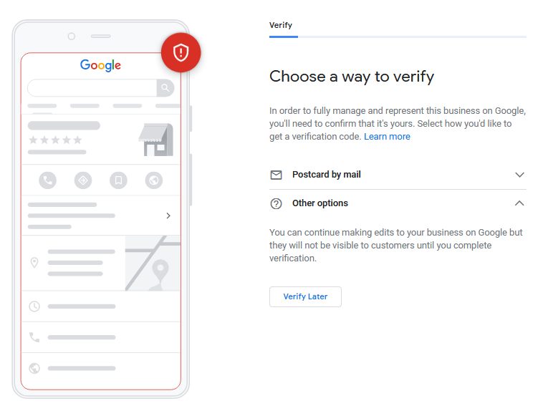
Choose A Way To Verify

Slide 41
Google will Snail Mail you a post card.

Slide 42
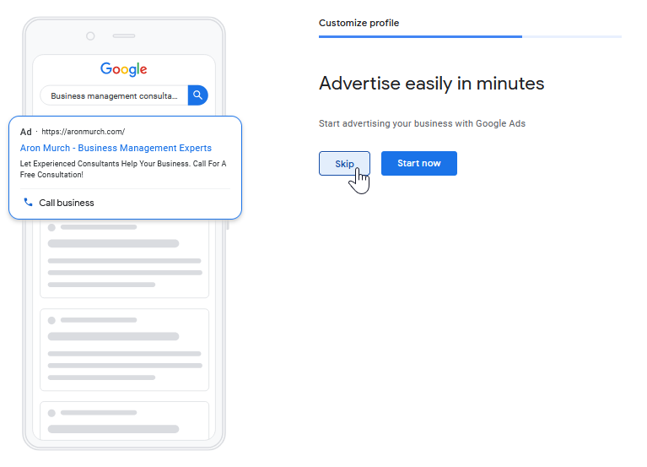
Skip Google Ads… Again

Slide 43
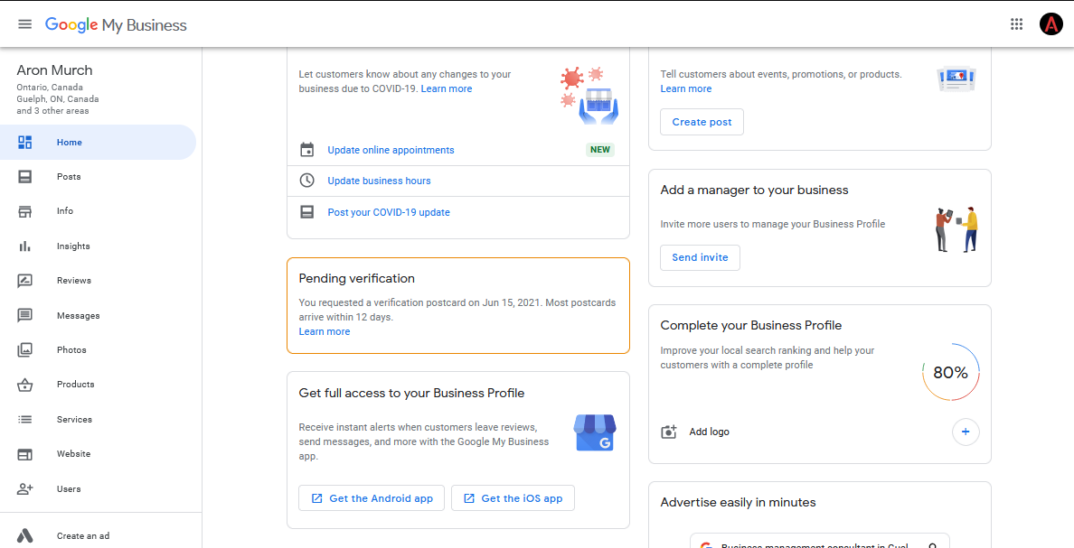
Enter Your Verification Code

Slide 44
Questions?
How do I get the slides?
Visit https://2h.media. The slides are on the workshop page.
How do we connect?
Follow 2H Media on LinkedIn.
Specific questions?
Give us a call.
P: 519-835-3009
E: hello@2h.media

