Slide 1
Introduction To Ecommerce
LAST UPDATED | JULY 21, 2021
LEARN WHAT IT TAKES TO SELL ONLINE.

Slide 2
Ecommerce
Web Development
Branding
People First Marketing
Email Marketing
Film & Photography
Education
Using transparency and communication to build business relationships.
Crowdfunding
Digital Marketing
P: 519-835-3009
E: hello@2h.media

Slide 3
What You’ll Learn
What is Ecommerce
Finding your Audience
Choosing a Product
Distribution 101
Reaching your Audience
Calculating Profitability
Resources
Q&A

Slide 4
What Is Ecommerce?
Ecommerce refers to commercial transactions conducted online.
Whenever you buy and sell something using the Internet, you’re involved in Electronic Commerce.

Slide 5
How Big Is Ecommerce?

Slide 6
Why Shoppers Buy Online?
Global audience
Easily scalable
Data gathering
Younger audience
Less risk

Slide 7
Why Sell Online?
Lower prices
Accessibility
Convenience
Wider selection of goods
Comfort
Repeatable purchases

Slide 8
Misconceptions About Ecommerce
Cheap & Easy
It’s passive income
No need to advertise
Great margins
Tax is hard
Not worth it if you have B&M

Slide 9
The Ecommerce Product Canvas
Audience
Product
Fulfillment
Marketing
Value
sprintpoint.ca

Slide 10
01
Audience
DETERMINING A TARGET MARKET, THEIR NEEDS AND THEIR VALUES

Slide 11
Audience
Starting with an audience ensures there is a market that will pay for your product.

Slide 12
What need are you trying to fulfill?

Slide 13
Audience
TRADITIONAL MARKET SEGMENTATIONS
Demographics
Geographics
Behaviouralistics
Psychographics
Check our resources for more information about Marketing Segmentations

Slide 14
Audience
WHAT DO YOUR CUSTOMERS VALUE?
Quality?
Great customer service?
Low prices?
Exclusivity?

Slide 15
Audience
VALUE
How much does your audience value solving the problem?
BUDGET
How much is your audience willing to pay?

Slide 16
Audience
Your product should entirely reflect your audience’s values.
If your audience demands high quality, your product can’t feel cheap.

Slide 17
Questions

Slide 18
02
Product
WHAT WILL YOU SELL TO FULFILL THE AUDIENCE NEED?

Slide 19
Product
How will your product solve your audience’s problem?

Slide 20
Product
What does the ideal Ecommerce product look like?

Slide 21
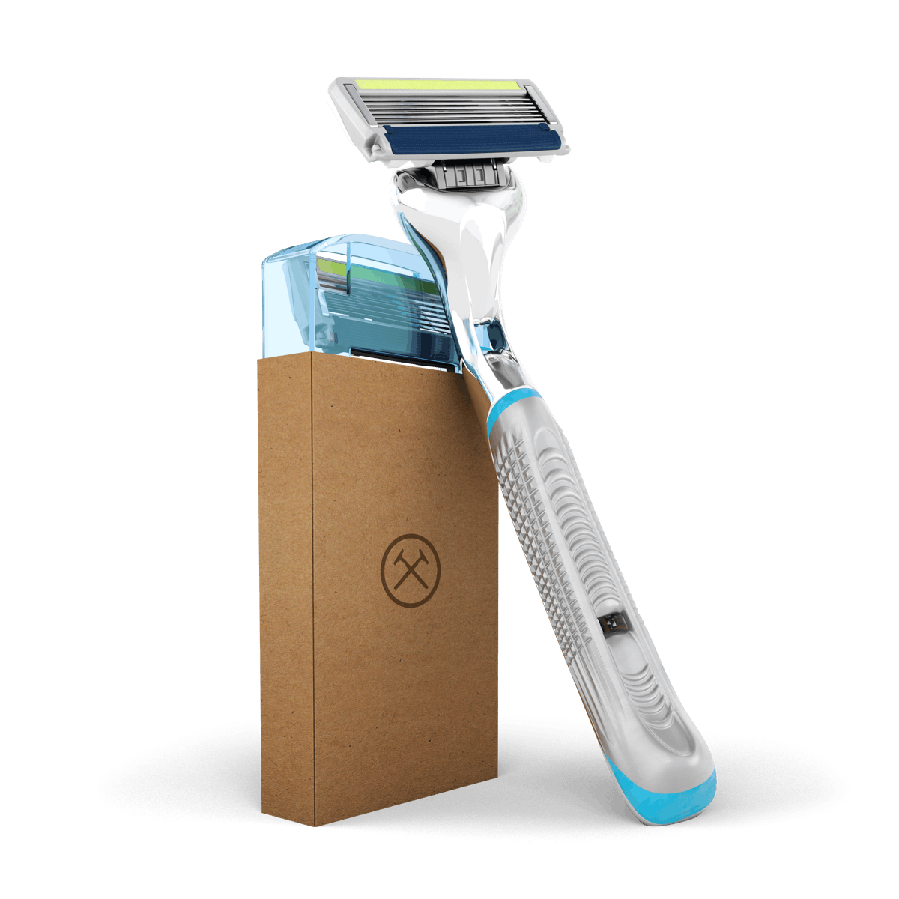
Product
IDEAL ECOMMERCE PRODUCTS
Digital products
Small and lightweight
High profit
Easily shippable
Online audience
Niche products

Slide 22
Product
REQUIRED PRODUCT INFORMATION
Price
Product Name
Photos / Video
Description
Measurements / Specifications
Warranty / Return Policy

Slide 23
Product
COMPLETE:
Solution
Product Info

Slide 24
Product
COMPETITION ONLINE IS FIERCE:
Do other similar products exist?
How much do they cost?
How is your audience finding competitor’s products?

Slide 25
Activity 1
COMPARE
Product pictures
Prices
Descriptions
Reviews
Website Quality
QUESTIONS
How many products did you find that solved your problem?
How wide was the price range?

Slide 26
Product
THERE IS NO FREE LUNCH ONLINE
Knowing the competitive landscape will help you determine your pricing, advertising strategy, and how to position your branding.

Slide 27
Product
MANUFACTURE VS. PURCHASE AND RESELL
What materials will you need?
Where will you get them?

Slide 28
Product
Importing Materials or Products
Wholesalers
Freight
Incoterms
EXW Guangzhou, CN
FOB Shenzhen, CN
DDP Guelph, CA
Check our resources for more information about Import/Export Terminology

Slide 29
Questions

Slide 30
03
Seller’s Journey
HOW ECOMMERCE LOOKS FROM THE SELLER’S PERSPECTIVE

Slide 31
Seller’s Journey
4 MAIN STEPS OF THE SELLER’S JOURNEY
Listing
Receiving Orders
Processing
Delivery

Slide 32
Seller’s Journey
STEP 1: LISTING
Listing your products online

Slide 33
What is a “listing”?

Slide 35
Seller’s Journey
Hosted Platform
Self-Hosted Platform
WHAT ARE THE 2 LISTING OPTIONS?

Slide 36
Hosted Platforms

Slide 37
Self-Hosted Platforms
+

Slide 38
Seller’s Journey
Access to a huge market
Complex and high fees
Check our resources for more information on Amazon stores

Slide 39
Seller’s Journey
STEP 2: RECEIVING ORDERS
How will I accept payments?

Slide 40
Payment Solutions

Slide 41
Seller’s Journey
FULFILLMENT
Warehousing, processing, and delivering orders to end customers

Slide 42
Seller’s Journey
STEP 3: ORDER PROCESSING
Pick - Finding & verifying the correct items
Pack - Packing the correct items securely
Ship - Getting your items to the Courier on time

Slide 43
Seller’s Journey
STEP 4: DELIVERY
Who can help you ship and different shipping models

Slide 44
Couriers

Slide 45
Alternative Shipping Providers & Software

Slide 46
Fulfillment
METHODS OF FULFILMENT
Direct Fulfillment
Third Party Logistics (3PL)
Dropshipping

Slide 48
5 Minute Break

Slide 49
04
Marketing
PRESENTING YOUR PRODUCT AND ONLINE STORE TO YOUR AUDIENCE

Slide 50
Marketing
FOCUSING YOUR EFFORTS
Understanding your customer will ensure you store stays aligned with their values You are not your target audience

Slide 51
Why is advertising a must?

Slide 52
Marketing
AVG. DIGITAL ADVERTISING CONVERSION
1.0 – 3.5%
AVG. ECOMMERCE CONVERSION RATE (US):
2.63%
This means roughly 1 in 2000 people who see your ad will actually purchase your product.

Slide 53
Marketing
HOW WILL YOUR CUSTOMERS DISCOVER YOU?
Social Media
Influencer Marketing
Paid Search
Traditional
Word of Mouth
Check our resources for more information on Influencer Marketing

Slide 54
Once your audience discovers your product, how will you get them to make the purchase?

Slide 55
Marketing
MARKETING PERSUASIONS
Authority
Scarcity
Commitment
Social Proof
Reciprocity
Liking
Check our resources for more information about Persuasions

Slide 56
Marketing
SCARCITY
Out-of-Stock
Limited-Time Tactics
Pre-orders
Check our resources for more information about Scarcity

Slide 57
What are common persuasions you have seen for selling products online?

Slide 59
Marketing
RETENTION
How can you turn 1 customer into 2?
How can you encourage repeat customers?

Slide 60
Referral Programs

Slide 61
Marketing
CART ABANDONMENT
Cart abandonment occurs when customers add items into their virtual shopping cart and then, for whatever reason, leave the website without completing their purchase.
Check our resources for more information about Cart Abandonment

Slide 62
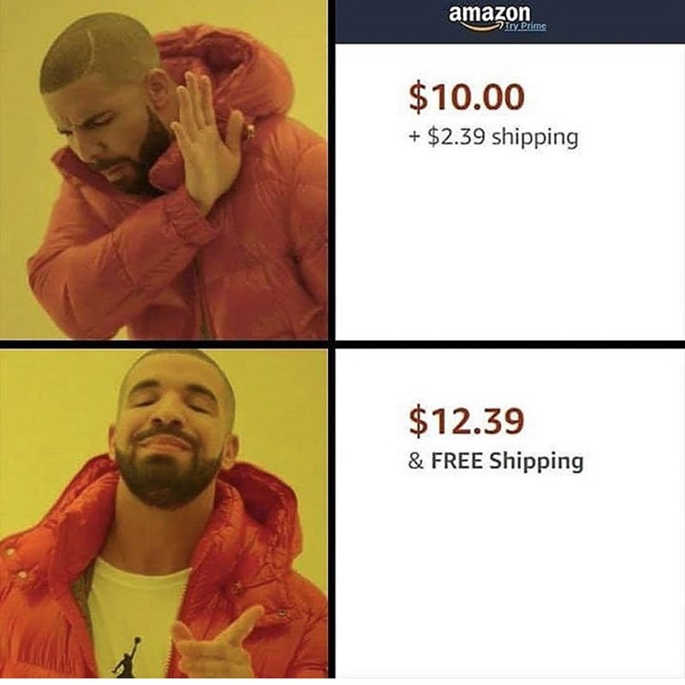

Slide 63
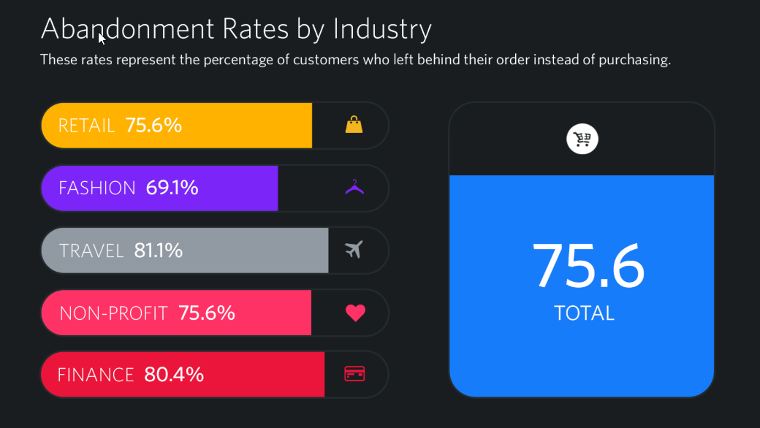

Slide 64
Marketing
TOP REASONS FOR CART ABANDONMENT
Unexpected shipping costs: 25%
Having to create a new account to finalize an order: 22%
Customers researching & comparing prices with no intention of buying: 17%
Check our resources for more information about Cart Abandonment

Slide 65
Store Branding

Slide 66
Product Branding

Slide 67
Marketing
Store and Product branding can be difficult.
Great design takes expertise.
This is your business! Hire an expert.
Reach out and start developing your support network!
Notes:
Matt

Slide 68
Marketing
ACTIVITY 2:
In 60 seconds find a product or store with GREAT branding that will attract their desired audience.
What makes their branding great?
Why will their target audience identify with their brand?
Notes:
Matt

Slide 69
Questions
Notes:
Matt

Slide 70
05
Value
DETERMINING YOUR PRICE AND VALIDATING YOUR IDEA

Slide 71
Value
Determining whether your product will be profitable is the last step of the Ecommerce Canvas.
WE TAKE INTO ACCOUNT:
Expenses
Break Even
Price Point

Slide 72
Value
Similar to traditional selling, Ecommerce has a variety of expenses:
One Time Fixed
Recurring Fixed
Variable

Slide 73
One Time Fixed Expenses
THIS MAY INCLUDE:
Designing Store Branding
Designing Product Packaging
Creating Marketing Collateral
We treat these expenses as assets

Slide 74
Recurring Fixed Expenses
THIS MAY INCLUDE:
Advertising / Marketing Campaigns
Hosting
Warehousing

Slide 75
VARIABLE EXPENSES
THIS MAY INCLUDE:
Labour
Payment Processing
Packaging

Slide 76
Value
BREAK EVEN
The Break Even point formula is calculated by dividing the total fixed costs of production by the price per unit less the variable costs to produce the product.

Slide 77
06
Resources
WHERE TO GO WHEN YOU GET STUCK

Slide 78
Resources
Udemy
Shopify Guides
Hubspot Academy
Check out www.2h.media for resources

Slide 79
Resources
Resources can be found at www.2h.media/workshops
Market segmentations - https://www.marketing91.com/4-types-market-segmentation-segment/
Persuasions - https://www.insites-consulting.com/6-principles-of-persuasive-marketing-how-to-influence-people/
Scarcity - https://www.referralcandy.com/blog/scarcity-marketing-examples/
3PL Distribution - https://www.youtube.com/watch?v=eCgHcLoOE8Y
Influencer Marketing - https://www.entrepreneur.com/article/324177
https://www.statista.com/statistics/379046/worldwide-retail-e-commerce-sales/

Slide 80
Resources
Incoterms: https://www.icontainers.com/us/2013/07/18/incoterms/
Logistics: https://www.inflowinventory.com/blog/small-business-3pl/

Slide 81
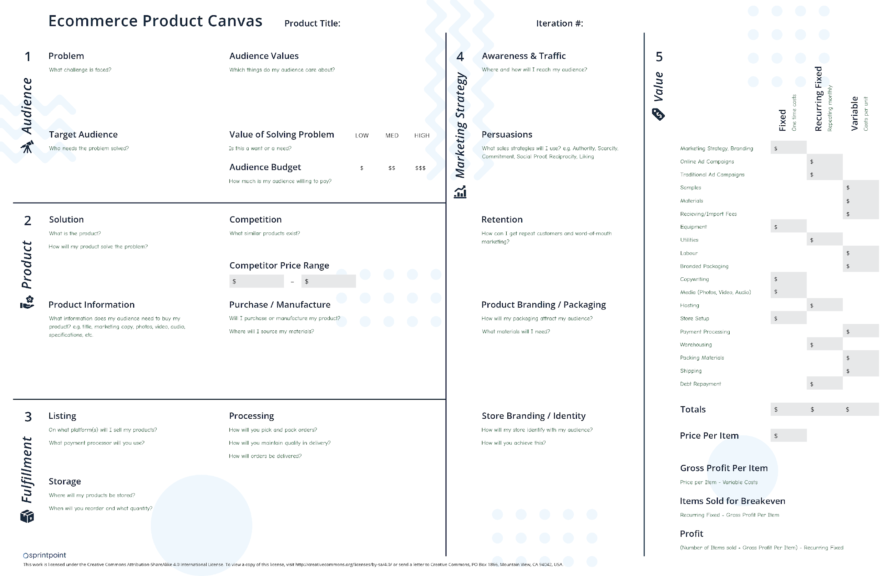
Questions?
How do I get the slides?
Visit https://2h.media. The slides are on the workshop page.
How do we connect?
Follow 2H Media on LinkedIn.
Specific questions?
Give us a call.
P: 519-835-3009
E: hello@2h.media
Validate your Ecommerce product idea with the Ecommerce Product Canvas.

