Slide 1
LinkedIn For Small Business
LAST UPDATED | JULY 21, 2021
REACH A PROFESSIONAL AUDIENCE ON LINKEDIN

Slide 2
Ecommerce
Web Development
Branding
People First Marketing
Email Marketing
Film & Photography
Education
Using transparency and communication to build business relationships.
Crowdfunding
Digital Marketing
P: 519-835-3009
E: hello@2h.media

Slide 3
What You’ll Learn
What is LinkedIn
Why it’s important
Getting started
Creating a Company Page
Tips & Tricks
Q & A

Slide 4
What Is Linkedin?
LINKEDIN
It’s a social network that is actually about networking. Post jobs, share your work experience, and extend your reach beyond friends and family.

Slide 5
Why Is It Important To Use Linkedin?
Deals are not signed on Instagram. Creating a successful network means connecting with real-world influencers.
Connect with past clients
Frame your content with a business focus
Immerse yourself in industry

Slide 6
01
Getting Started

Slide 7
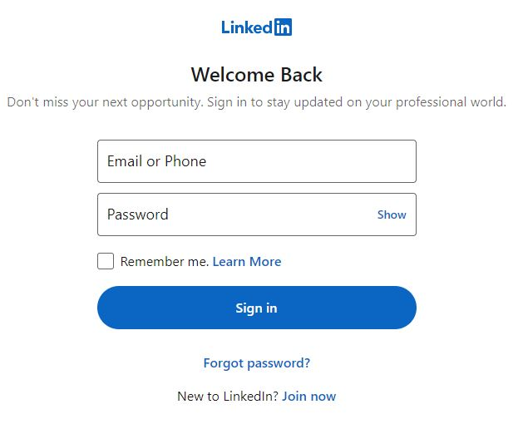
Sign-in To Linkedin
STEP BY STEP
Open a web browser
In the search bar enter www.linkedin.com/login
Sign-in to your account.*
*If you do not have an account, raise your hand.

Slide 8
It starts with you
YOUR PERSONAL LINKEDIN PROFILE
In most cases, your personal profile will be your first online impression on members of your network.
Make it your profile. Be authentic, honest and professional.
You need a personal profile to create a company page.
Take the time to develop your history.

Slide 9
02
Making Connections

Slide 10
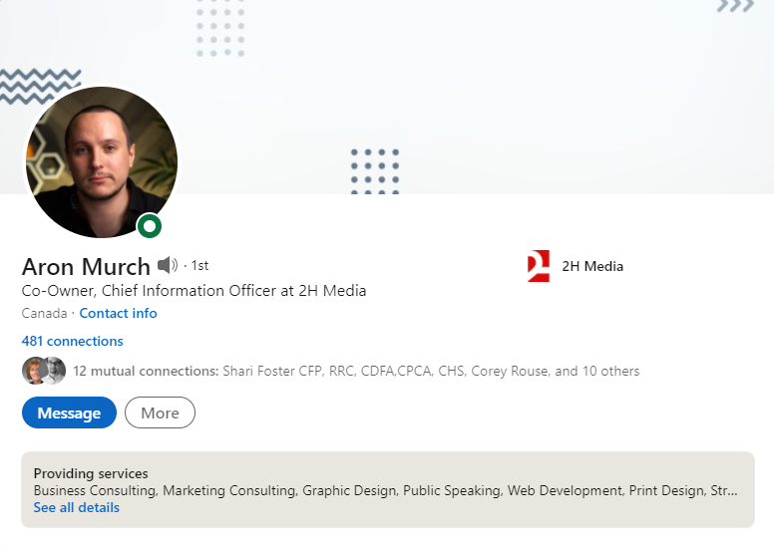
Start Making Connections

Slide 11
Keep connecting
PEOPLE YOU MAY KNOW
LinkedIn makes it very easy to connect with other professionals, colleagues, and past clients.
Click on “My Network” in the menu.
Start scrolling.
Click connect for everyone in your professional network.
Use the search bar to find specific people.

Slide 12
03
Creating a Company Page

Slide 13
Access “Create a LinkedIn Page”
Click “Work” in the header menu.
Then click “Create a Company Page”

Slide 14
Create a LinkedIn Page
SELECT THE CORRECT SIZE OF BUSINESS.
If you have more than 200 employees, congratulations.

Slide 15
Page Identity and Company Details

Slide 16
Input Your Profile Details And Preview
PAGE IDENTITY
How is your company displayed online?
COMPANY DETAILS
What does your company do, and what is its scale?
PROFILE DETAILS
Very basic branding.

Slide 17
Your Company Admin View
START EDITING WHAT PEOPLE SEE
On this page we will be adding more key information:
Company Description
Specialties
Address

Slide 18
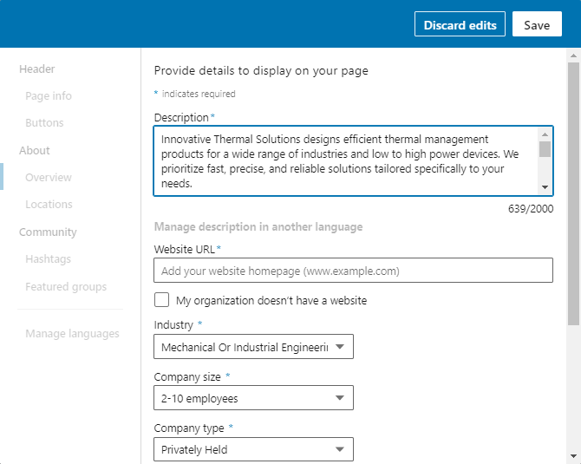
Your Company Admin View
FROM THE ADMIN VIEW
Click the “Add” button in the box labelled “Description”.
ENTER YOUR COMPANY DESCRIPTION
Aim for a minimum of 500 characters.
Write your description like an executive summary or elevator pitch; try to capture how you solve problems and how you are differentiated.

Slide 19
Specialties
Scroll to the bottom of the page, and you will find the Specialties section.
Specialties are keywords that help people find your business.
Add up to 20 keywords.
Make specific to your business.
When you are done, click “Save”.

Slide 20
Back To The Admin Panel
Almost done!
Click the “Add” button in the box labelled “Location”.

Slide 21
Add Your Company Address
Take some time to fill in your address details.
If you do not have a business address, click the box labelled, “My organization doesn’t have a street address”.

Slide 22
Create Your First Company Post
Announce your new company page.
Describe what your company does.
Remember to tag 2H Media so that we can leave a comment.

Slide 23
How Your Post Appears
Your company post appears in your feed along with some basic information such as company name, post date, and follower count.
From here, people can like, comment on your post, and share it to their personal or company pages.

Slide 24
Follow A Hashtag
From the admin panel, click the “Add” button in the box labelled “Hashtags”.
On the “Edit” screen, click the “Add a hashtag” link.
Add up to 3 hashtags that are relevant to your business.

Slide 25
Adding an additional User
Last steps!
Click “Admin tools” in the top right corner of the page. Then, click “Manage admins” in the dropdown menu.

Slide 26
Managing Your Admins
From here you can add new users that can act on behalf of your company page.
Enter a user in the search bar, and send them an invite (they will also need a personal LinkedIn profile).

Slide 27
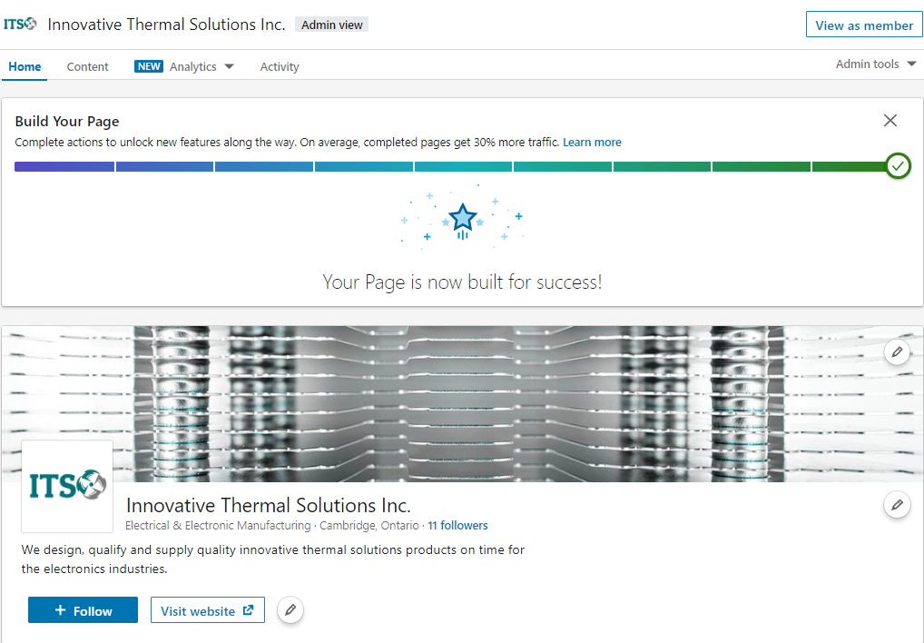
Page Complete

Slide 28
04
Tips & Tricks

Slide 29
Supercharge Your Followers
INVITE CONNECTIONS TO FOLLOW
You get 100 credits per month. Aim to use all of them.
Whenever someone accepts, you get your credit back early.

Slide 30
Supercharge your followers
CREATE YOUR OWN CROSS-POSTING
Alternate between posting on your personal page and your company page.
This method makes connections that do not follow your page more likely to see your content.

Slide 31
Questions?
How do I get the slides?
Visit https://2h.media. The slides are on the workshop page.
How do we connect?
Follow 2H Media on LinkedIn.
Specific questions?
Give us a call.
P: 519-835-3009
E: hello@2h.media

